Slide 1
Ministry category : DIPP Problem Statement : Platform to connect Startups with Corporates College Code : 802 Team Leader Name : Amit Sahu Problem Code: DM6
Idea: Engaging with Startups can be one way for Corporate to get fresh ideas. There is an impending need for creating a platform for Corporate and Startups to connect, exchange their innovative ideas and collaborate to solve wide array of industry problems. The platform shall fulfill following two key objectives:
1) Corporate shall be able to list challenges and source ideas from innovators.
2) Innovators shall be able to publish their innovative business ideas and attract interest from corporate.
Solution: For this purpose we develop a web-app where we divide users in two groups, as corporates and innovators. Corporates and innovators will have to create their account where corporates profile contain basic details along with company name/LLP name, DIN, business activity, its public/private/partnership status, address, contact number, e-mail, company’s official website link etc. which will help to prove company/organization’s authenticity. Innovators profile will have basic detail of user along with their educational details, skills, jobs(if any), internships(if any), projects(if any), additional details.

Slide 2
Innovators can post their ideas/project details/startups, images, videos, documents etc. related to their projects. Corporates will have to follow the innovators by which they can get innovators’ posts on their timeline, same will be applied to innovators also, innovators will see corporates problem statements on their timeline. Both the user can communicate through chat box where innovator can present their startups’ report and ideas to corporate and requests for investment or raise funds. Innovators’ post can’t be seen by other innovators to maintain privacy of ideas and projects, only corporate will be able to access feeds of innovators.
Technology Stack:
Front end will be developed using HTML/CSS/JavaScript and JavaScript’s Frameworks
Backend will be developed through Node.js with Express Framework and MongoDB database
Dependencies/Showstoppers: No dependencies/showstoppers.

Slide 3
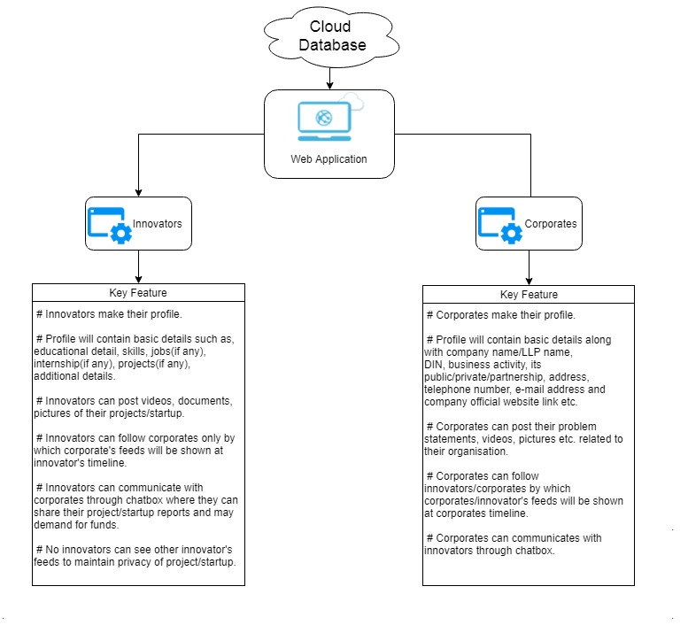
UML Case Diagram

Slide 4
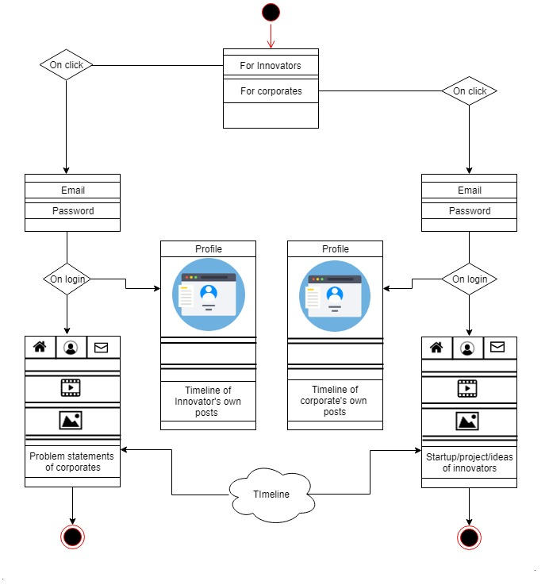
Web-app Flow Diagram

